Slide 1


FULL STACK WEB DEVELOPMENT WITH DJANGO
Lecture 35

Slide 2

Today’s Agenda
Developing Our Django App
Drawbacks Of Cookies
Introducing Sessions
Understanding Django’s Session Framework
Django’s Default Set Up For Sessions
Testing Cookie

Slide 3
Drawbacks Of Cookies
Although cookies are vey useful, but they have following problems.
An attacker can modify the contents of a cookie that could potentially break our application. How ?
Because HTTP data is sent in cleartext, cookies are extremely vulnerable to sniffing attacks.
That is, an attacker who is sniffing on the wire can intercept a cookie and read it. This means we should never store sensitive information in a cookie.

Slide 4
Drawbacks Of Cookies
We can only store a limited amount of data in cookies.
Most browsers don't allow a cookie to store more than 4KB of data.
Breaking data into multiple cookies causes too much overhead in each request.
Further, we can't even rely on the number of cookies allowed by the browser for each domain.

Slide 5
Sessions As Rescuer!!
With all of these limitations and potential security holes, it’s obvious that cookies and persistent sessions are examples of those “pain points” in Web development.
Of course, Django’s goal is to be an effective painkiller, so it comes with a session framework designed to smooth over these difficulties for us.

Slide 6
Understanding Django Session Framework
When we use sessions the data is not stored directly in the browser , instead it is stored in the server.
Django creates a unique random string called session id or SID and associates this SID with the data.
The server then sends a cookie named sessionid containing SID as value to the browser.

Slide 7
Understanding Django Session Framework
On requesting a page, the browser sends the request along with the cookie with SID to the server.
Django then uses this SID to retrieve session data and makes it accessible in our code.
SID generated by Django is a 32 characters long random string, so it is almost impossible to be guessed by an attacker.

Slide 8
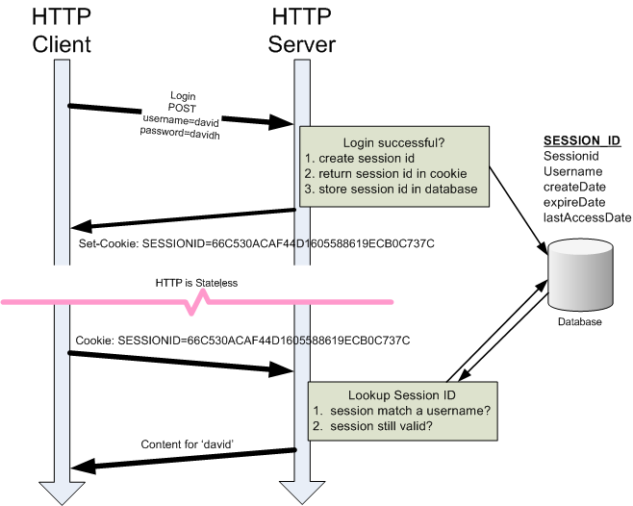
Understanding Django Session Framework

Slide 9
Django’s Session Set Up
Django considers the importance of sessions over the website.
Thus it provides us with middleware and inbuilt app which will help us implement sessions without much hassle.
The 'django.contrib.sessions.middleware.SessionMiddleware' is responsible for generating unique SID.
Django provides an app called 'django.contrib.sessions' whose role is to store the session data into the database

Slide 10
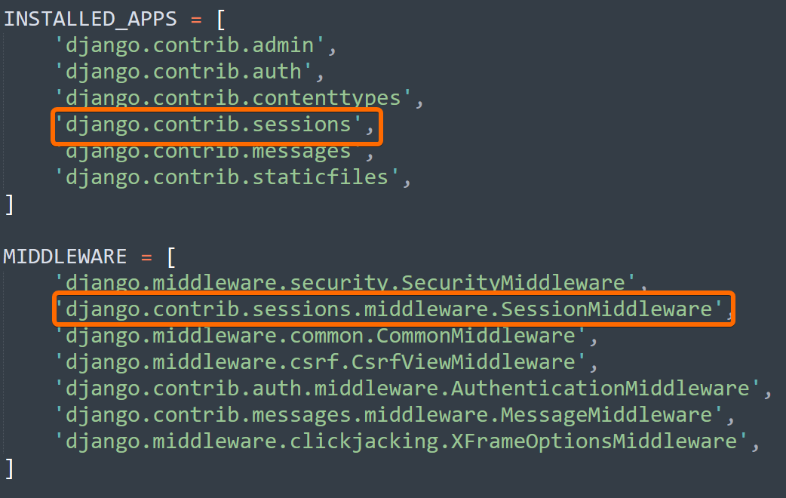
Django’s Session Set Up

Slide 11
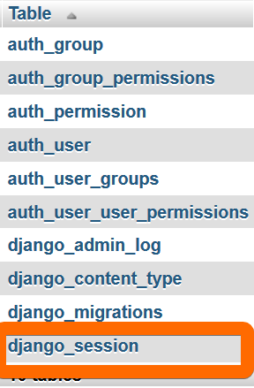
Django’s Session Set Up
When we migrate the application, we can see the django_session table in the database.

Slide 12
Testing Sessions
We know that users can configure their browsers to not accept any cookie.
As a result, Django provides some convenience methods to check cookies support in the browser.

Slide 13
Testing Sessions
The request.session object provides the following three methods to check cookies support in the browser.
Method | What it does?
set_test_cookie() | sets the cookie in the browser
test_cookie_worked() | returns True if browser accepted the cookie(a browser accepted the cookie means, it has sent the cookie to the server in the next request), Otherwise False
delete_test_cookie() | delete the test cookie

Slide 14
Code For Testing Cookie Support
Let’s write an app to check whether the browser is currently supporting cookies or not.
Create a simple Django app and in the views.py add the two view functions as shown in the next slide

Slide 15
Code For Testing Cookie Support
def test_session(request):
request.session.set_test_cookie()
return HttpResponse("Testing session cookie")
def test_delete(request):
if request.session.test_cookie_worked(): request.session.delete_test_cookie()
response = HttpResponse("Cookie test passed")
else:
response = HttpResponse("Cookie test failed")
return response

Slide 16
Code For Testing Cookie Support
The test_session() view sets the cookie and test_delete() checks whether the browser accepted the cookie or not.
Add the following two URL patterns at the beginning of urlpatterns list in app's urls.py.
urlpatterns = [
path(“test-delete/”, views.test_delete),
Path(“test-session/”, views.test_session)
]

Slide 17
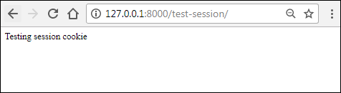
Code For Testing Cookie Support
Open the browser and type the url to http://127.0.0.1:8000/test-session/ and you should see a page like this:

Slide 18
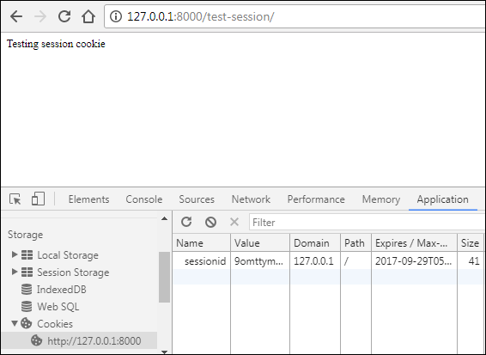
Code For Testing Cookie Support
Open Developer Tools by hitting Ctrl+Shift+J and click on the Application tab
If the browser accepted the cookie it should look like this:

Slide 19
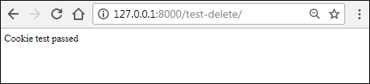
Code For Testing Cookie Support
Now visit http://127.0.0.1:8000/test-delete/, if everything went fine, it would show "Cookie test passed" response.
On the other hand, if it shows "Cookie test failed" message then check the browser settings and allow websites to save cookies.

